Slide 1

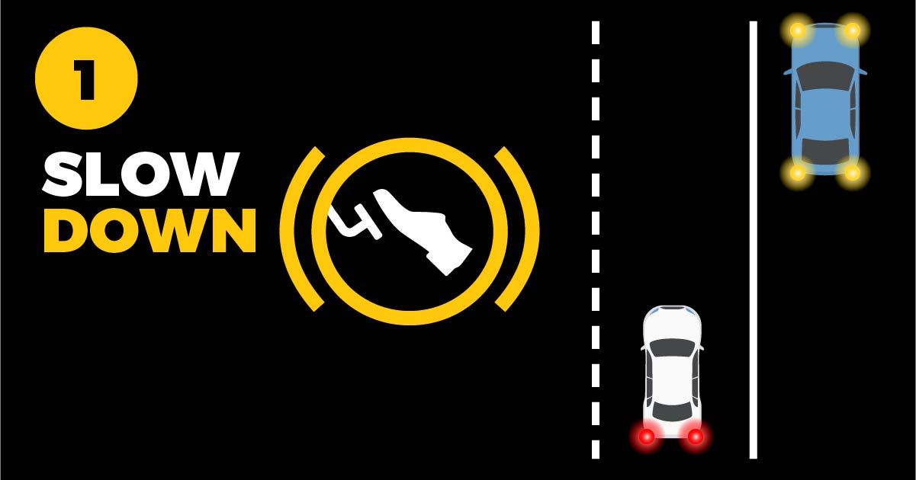

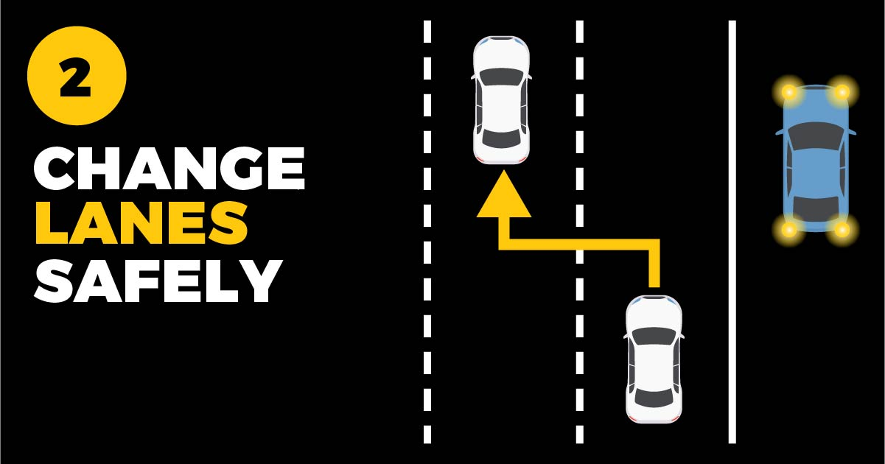


The “Move Over” Law requires passing drivers to slow down and change lanes safely when approaching ANY vehicle with their hazard lights on, not just emergency and maintenance vehicles.
WHAT TO DO
when you see ANY vehicle with flashing lights

