Slide 1
Capital Plan Update
Manar Nashif, Chief Engineering Officer
May 2025

Slide 2
Capital Programs Update
Timeline
2012 | 2013 | 2014 | 2015 | 2016 | 2017 | 2018 | 2019 | 2020 | 2021 | 2022 | 2023 | 2024 | 2025 | 2026 | 2027 | 2028 | 2029 | 2030 | 2031
MOVE ILLINOIS
2012-2027
BRIDGING THE FUTURE 2025-2031
Notes:
`This is an overall timeline for the Move Illinois and Bridging the Future capital programs. Starting this year, there will be a three-year overlap between Move Illinois and Bridging the Future. Move Illinois is scheduled through 2027 while Bridging the Future is scheduled through 2031.
The pressure is on for us to execute on all the current and future opportunities you will learn about today, but if the success of Move Illinois thus far is any indication, we at the Tollway are up to the task.
We look forward to wrapping up Move Illinois over the next three years and bring its momentum into the new Bridging the Future program..

Slide 3
Bridging the Future Overview and Themes
$2 billion, seven-year capital plan
Improving Mobility
Connecting Infrastructure
Modernizing the System
Preparing for Tomorrow
Notes:
Bridging the Future is a $2 billion, seven-year capital plan approved by the Board in December 2024.
Addresses system needs and infrastructure modernization
Built on feedback gathered through next capital planning outreach
Serves as a bridge between Move Illinois and the next major capital program
4 Key Themes:
Connecting infrastructure – Improving system access and interconnectivity
Improving mobility – Expanding capacity and reducing congestion
Modernizing the system - Strengthening infrastructure and upgrading facilities
Preparing for tomorrow – Exploring and implementing new technologies

Slide 4
Professional Services Highlights
CONTRACTS ADVERTISED
UPCOMING CONTRACTS
I-355/I-88 Interchange Master Plan
Seven design contracts
IL 390 – Lake Street to County Farm Road
Bridge reconstruction along I-294
Railroad bridge reconstruction
Tier 2 toll plaza improvements
I-90 roadway and bridge rehabilitation
Two construction management contracts
Eight design contracts
Rehabilitation and add lane
Bridge reconstruction
Fiber optic improvements
Two construction management contracts
Notes:
Contracts Advertised:
Master Planning for I-355/I-88 interchange Improvements
Design for IL Route 390 from Lake Street to County Farm Road
Two contracts for design for bridge reconstruction along I-294
Three contracts for design for railroad bridge reconstruction along I-294 and I-88
Four contracts for design for Tier 2 plaza improvements
Design for roadway and bridge rehabilitation along I-90
Two contracts for construction management along I-294
Upcoming Contracts
Design for in-road electric vehicle charging
Four contracts for design of roadway widening along I-88, I-94 and I-355
Two contracts for bridge reconstruction along I-94
Design for fiber optic improvements
Two contracts for construction management for bridge rehabilitation along I-88

Slide 5
Construction Highlights
11 contracts worth $90 million scheduled to advertise in 2025
CONTRACTS ADVERTISED
UPCOMING CONTRACTS
Drainage improvements
Two landscape contracts
I-355 bridge rehabilitation over Des Plaines River Valley
I-88 bridge rehabilitation
Systemwide bridge rehabilitation
ATMS, ITS and fiber installation
Noise abatement wall
Landscaping
Asphalt overlay and pavement markings
Notes:
11 contracts worth $90 million scheduled to advertise in 2025
Contracts Advertised
2013: I-294 Drainage Improvements at 75th Street Interchange*
2015: I-355 Bridge Rehabilitation over Des Plaines River Valley
2016: I-294 Landscape Planting Improvements, I-55 to Plainfield Road
2017: I-294 Landscape Planting Improvements, 95th Street to I-55
*First construction contract scheduled for May Board approval
Contract 2013 – I-294 Drainage Improvements at 75th Street Interchange
NTP Anticipated July 2025
Upcoming Contracts
2014: ATMS, ITS and Fiber Installation, North Avenue to Balmoral Avenue
I-294 Noise Abatement Wall Installation at Archer Avenue and 71st Place
Landscape Planting Improvements, I-55 to Cermak Rd.
Systemwide Bridge Rehabilitation
I-88 Bridge Rehabilitation
Asphalt Overlay and Pavement Markings, Flagg Creek to Cermak Rd.

Slide 6
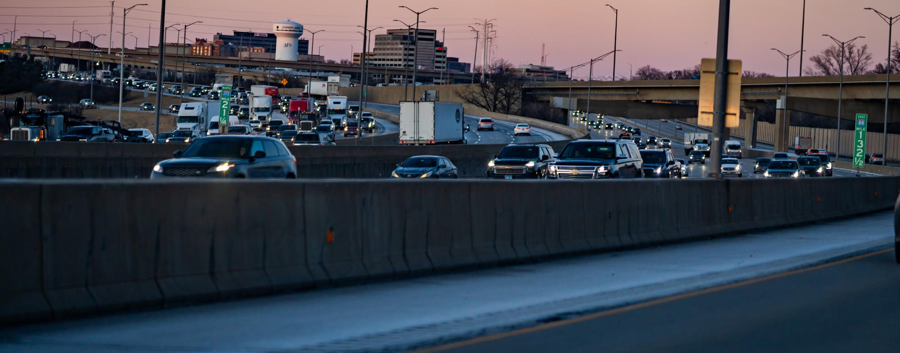
I-355/I-88 Interchange Project
Master planning services awarded in January 2025
MASTER PLAN
CONSTRUCTION
DESIGN
300,000 daily vehicles
Provide congestion relief
Address aging infrastructure
Enhance access and improve mobility
Notes:
Next, I want to highlight a project that will begin this year, funded by the Bridging the Future program: a master plan contract for the I-355/I-88 Interchange Project. ​
​The Master Plan will develop an overall interchange improvement solution – to provide congestion relief, enhance access, improve traffic operations and mobility, and modernize the interchange areas, including six miles of 355 mainline and five miles of I-88​. ​
​The master plan contract will lead to several opportunities for those in this room – as the master plan will identify additional design, construction and construction management contracts. One of the deliverables of the master plan is to identify the construction cost estimates, schedule, and contract packaging.​
​This is an essential initiative for the Tollway, as it is one of our system hot spots for congestions. But given the magnitude of the project, it will also require extensive coordination with more than 20 different agencies along the study area, not including the utility firms. ​
​By advancing the master plan, we are ensuring that critical work at this interchange is well coordinated, comprehensive and can begin as soon as possible. We look forward to sharing more about this interchange as work progresses.

Slide 7
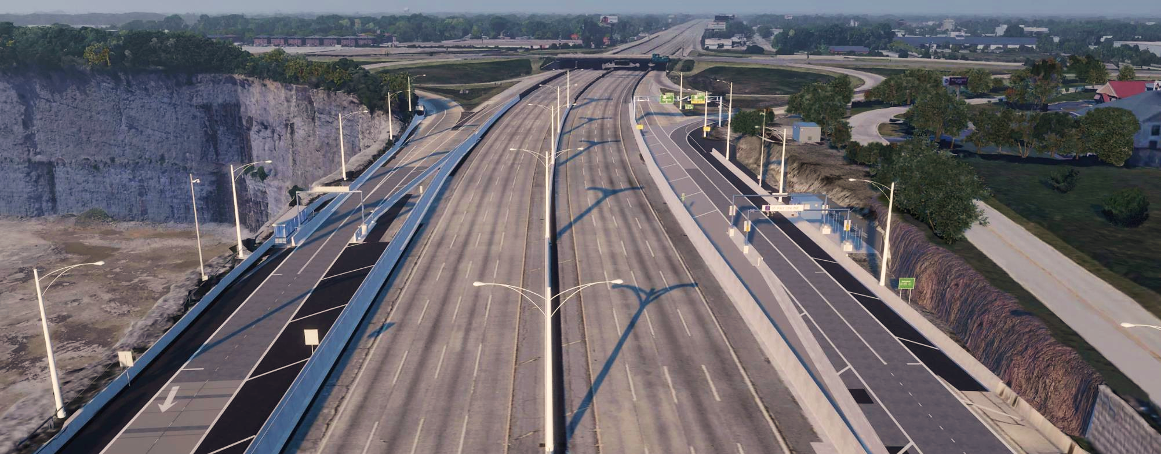
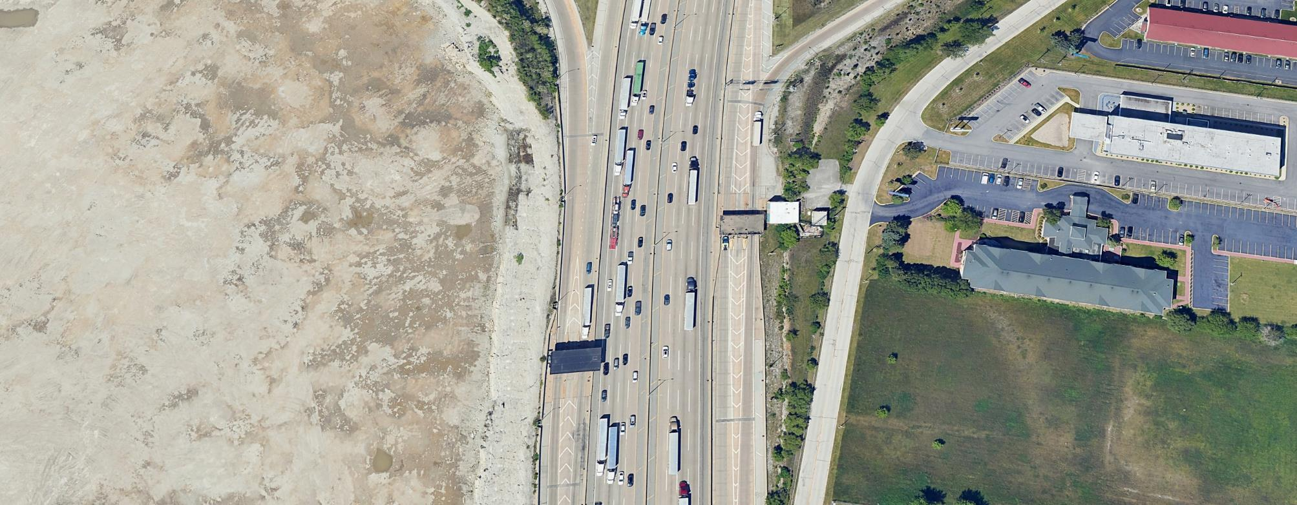
Tier 2 Toll Plaza Improvements
A multi-tiered approach
RAMPS TO/FROM HALSTED STREET
HALSTED STREET
THORNTON QUARRY
TOLL PLAZA 47 (EB)
TOLL PLAZA 47 (WB)
THORNTON QUARRY
TOLL PLAZA 47 (WB)
TOLL PLAZA 47 (EB)
Become a barrier-free system
Improve traffic operations
Address aging infrastructure
Eliminate roadway obstacles
Notes:
One of our initiatives is to address several plazas – examining them for overall health, but also for potential opportunities. This is an important topic, as you’ll see work opportunities related to plazas on PSB 25-1, and we want industry to understand our intent.
The goals of our Plaza improvements are to become a barrier-free Tollway system, improve traffic operations, address aging infrastructure, and eliminate roadway obstacles that are no longer necessary with the transition to cashless tolling.
The introduction of Bridging the Future has allowed us to create two separate tiers of plazas to ensure improvements are met in an organized and timely manner.
“Tier 1” plaza projects are underway as part of Move Illinois and will continue throughout the program’s duration, addressing those in poor condition and in need of operational enhancements. “Tier 2” plaza projects will roll out in the Bridging the Future program this year, which will be coordinated with adjacent Tollway projects and focus on tolling approaches and modifications.
We look forward to addressing the Tollway’s plazas through these two tiers and beyond, executing enhancements on one of the most important assets of our operations.

Slide 8
THANK YOU

